Slide 1
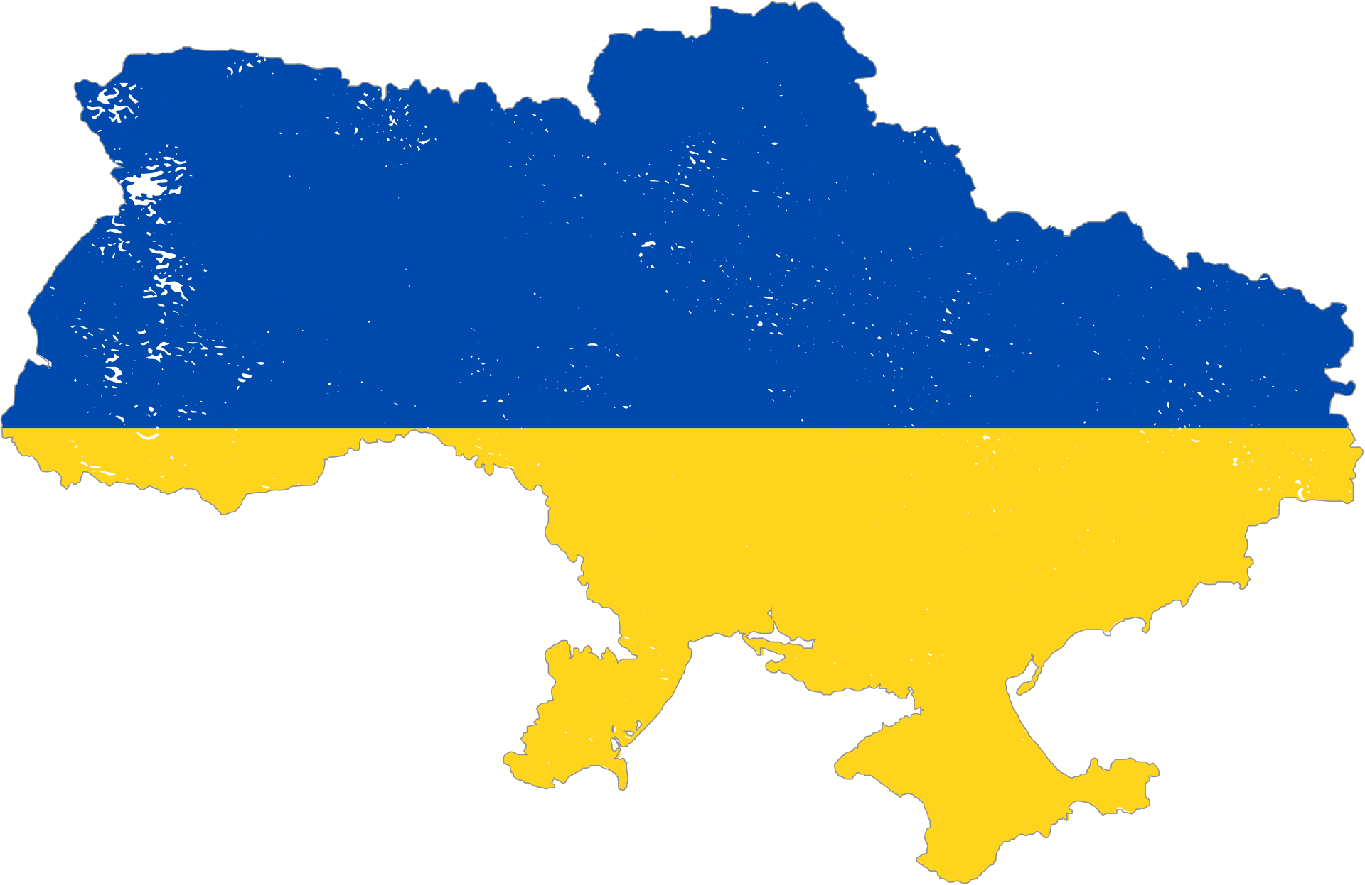
WHO WE ARE
Plus 6,367 new charitable organizations
And plus 2,760 new public organizations
in 2022.
In the first months of the full-scale war, the civil society sector of Ukraine and a spontaneous powerful volunteer movement did everything possible and impossible to prevent a humanitarian crisis in Ukraine.

Slide 2

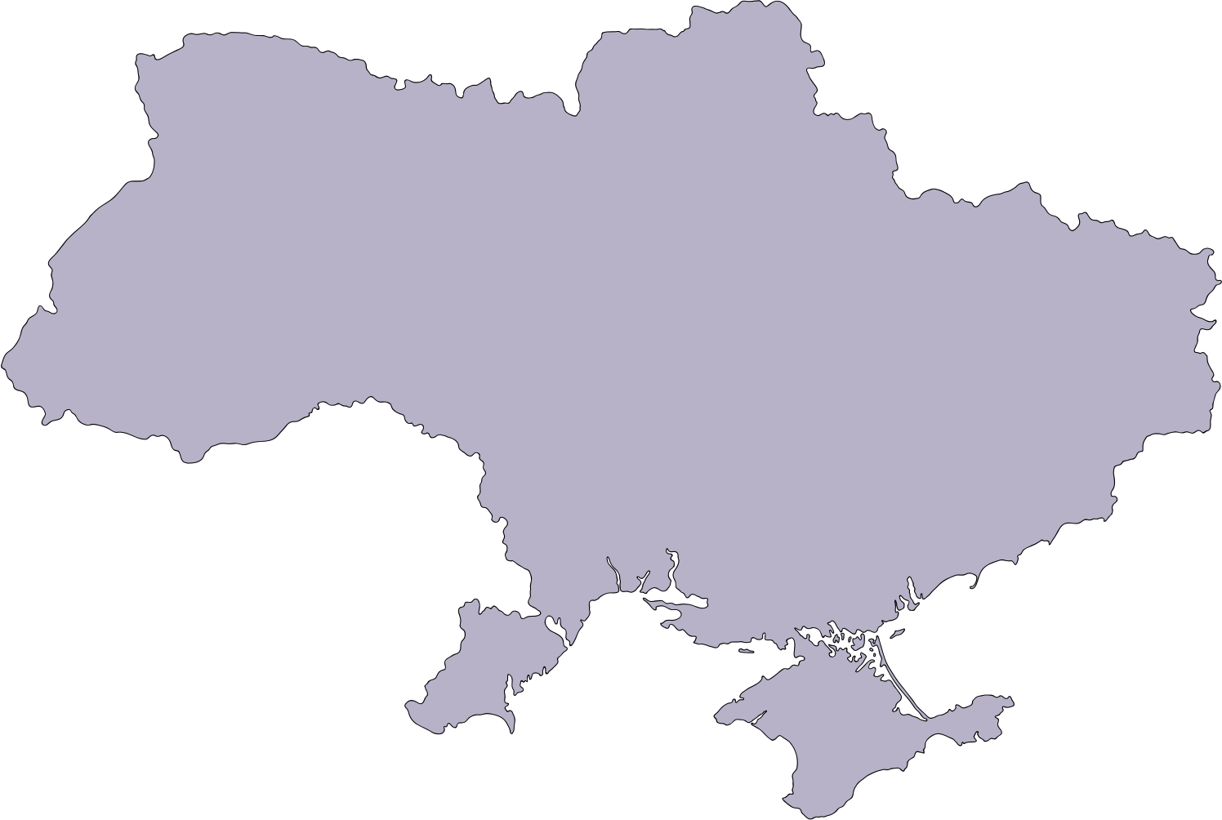

In the new realities of the war, we have a triangle of actors who are working to respond to the humanitarian crisis and will also be working on early recovery and renewal/reconstruction
Ukrainian Government (national and local)
GREAT LEADERS HAVE STRONG WORKING RELATIONSHIPS
The International Community
(INGO, the UN system, Institutional donors)
Ukrainian
civil society
Private sector
we build bridges to unite all actors and learn how to cooperate for joint effective action

Slide 3
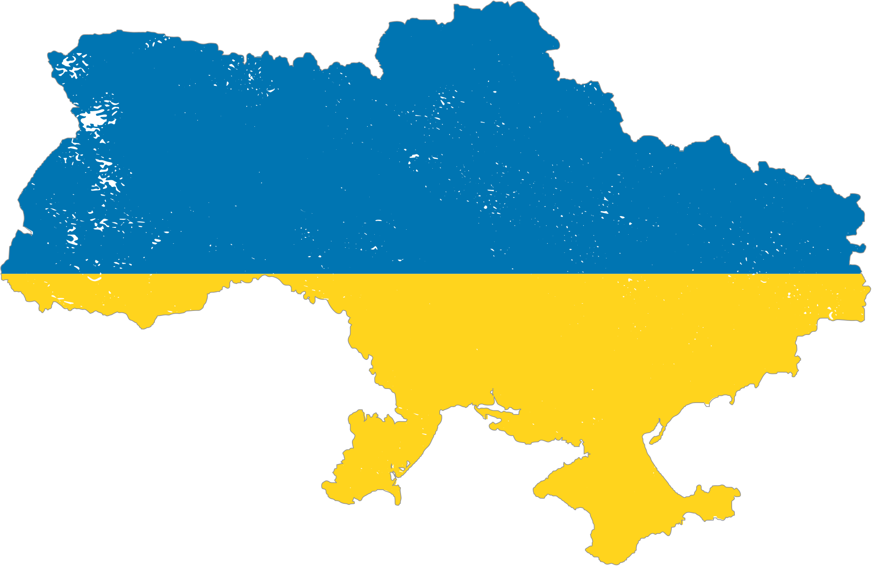
LOCALLY LED RESPONSE IN UKRAINE
Building on the belief that the most effective way to grow is by connecting with like-minded, with whom you can exchange ideas, best practices, and insights, our initiative group decided to create a dedicated, unbiased environment for localization leaders.
At the start, we brought together 15 Ukrainian CSOs representing various areas of work of Ukrainian civil society - from humanitarian to capacity building and development.
WE ARE WORKING ON
community that networks and creates opportunities for Ukrainian NGOs to
  be visible
  be supported
  be developed
  be effective
  be transparent and understandable
  be participants in a large humanitarian and recovery framework
Unite & empower Ukrainian NGOs to ensure effective locally led response.

Slide 4
WHAT DO WE WANT?
There are four areas we have identified, which are important:
1. Advocacy and a stronger voice of civil society in cooperation with international actors.
2. Access of Ukrainian organizations to funding streams, including initiative for:
  Verification/Passporting
  Capacity strengthening
  Pooled funding for smaller local organizations with simplified application requirements
  IT solutions/platforms where organizations and donors can find one another
  Communication strategy – informing Ukrainian NGOs about the mechanisms of involvement in international funding.
3. Positioning of Ukrainian civil society in Ukraine – building partnership with the Government: to influence Ukrainian legislation, as well as contributing towards the decentralization process.
4. Cross cutting issue: Building a bridge between national actors and local organizations, enabling the voice of local organizations to be heard.

Slide 5
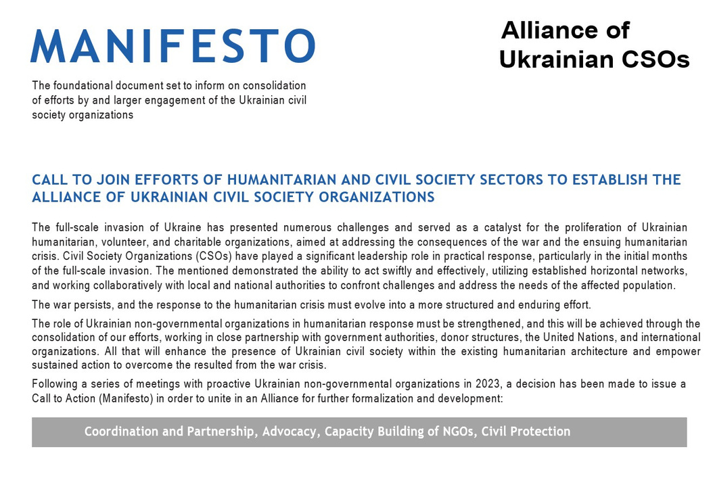
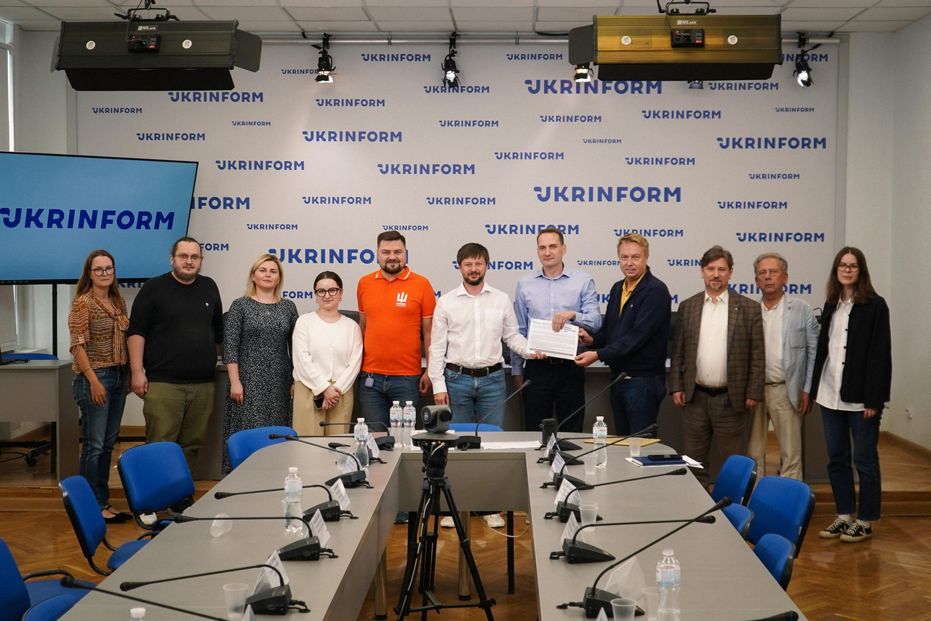
TIMELINE
On May 5, the first meeting of Ukrainian NGOs took place to discuss the Ukrainian program to strengthen localization - Locally led response.
On July 8, 9, a workshop-retreat was held, where the community identified gaps, brainstormed how to strengthen the Locally led response in Ukraine, and decided to create an informal union. Shared this idea with UN OCHA, NGO Platform, UHF.
On September 22, 2023, in Kyiv, the Manifesto on the establishment of the Alliance of Ukrainian Civil Society Organizations was signed.
During 7 months, the community has regular meetings.

Slide 6





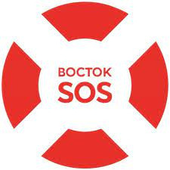

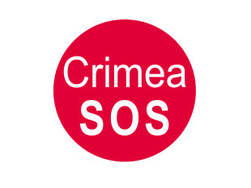








16 CIVIL SOCIETY ORGANIZATIONS - PART OF INITIATIVE GROUP

Slide 7
РОБОЧА ГРУПА/
work groups
Alliance
of Ukrainian CSOs structure
Направляє АУ ОГС/
Guides the AU CSOs
Очолює АУ ОГС/
Leads the AU CSOs
РОБОЧА ГРУПА/
work groups
СЕКРЕТАРІАТ
SECRETARIAT
НАГЛЯДОВА РАДА/
SUPERVISORY BOARD
РОБОЧА ГРУПА/
work groups
РОБОЧА ГРУПА/
work groups
РЕГІОНАЛЬНІ ХАБИ/
LOCAL FOCAL POINTS
РОБОЧА ГРУПА/
work groups
КОНСУЛЬТАТИВНІ ГРУПИ/
ADVISORY GROUPS
Зв'язок з регіонами/
Сonnection with regions
РОБОЧА ГРУПА/
work groups
Проводить роботу за напрямками/
Carries out the work
ЧЛЕНИ АУ ОГС/
AU CSOS MEMBERS
Консалтинг стейкхолдерів/
stakeholder consulting
Перед ким підзвітна АУ ОГС/
To whom is the AU CSOs accountable

Slide 8
NEXT STEPS
1. Recruitment of support staff for the Alliance of Ukrainian Civil Society Organizations secretariat. Launched Oct. 1 & ongoing (Ukrainian Red Cross lead).
2. Development and approval of the guiding Bylaws of the Alliance of UA CSOs. Ongoing. (Caritas Ukraine legal staff lead).
3. Launch of working groups:
  Advocacy
  Quality of partnership
4. Membership Criteria - door for new organizations will be opened after organizing all the workprocesses (spring 2024). (Caritas Ukraine legal staff lead).
5. Panel discussion around the Alliance UA CSOs and the culture of partnership in Ukraine at the ISAR Ednannia Civil society development forum (December, 5).
6. Launch of Conference Series in the regions, as the first step in setting up regional hubs (tentive January – February). Identification of leaders and existing platforms in the regions that can be supported in the future.

Slide 9
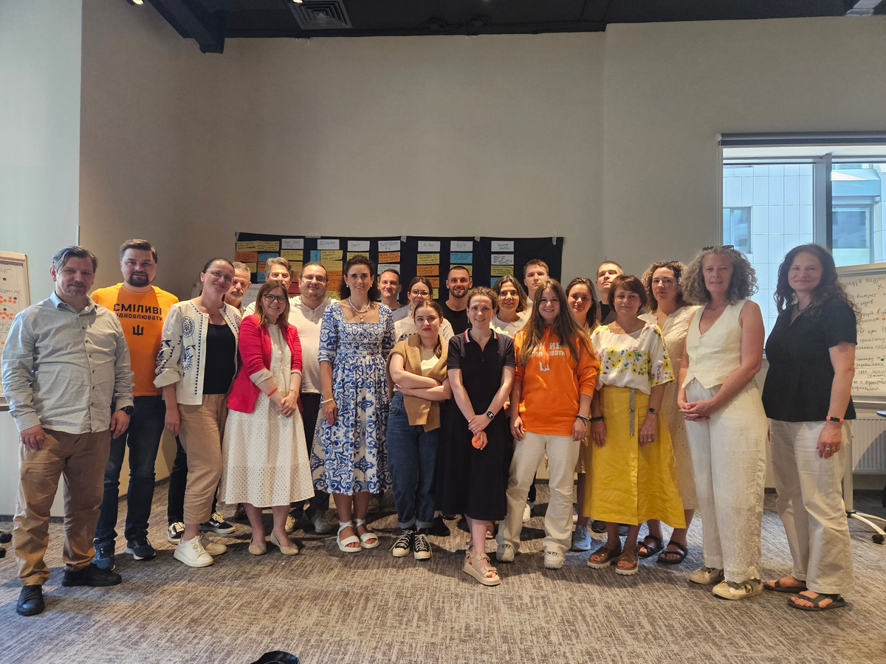
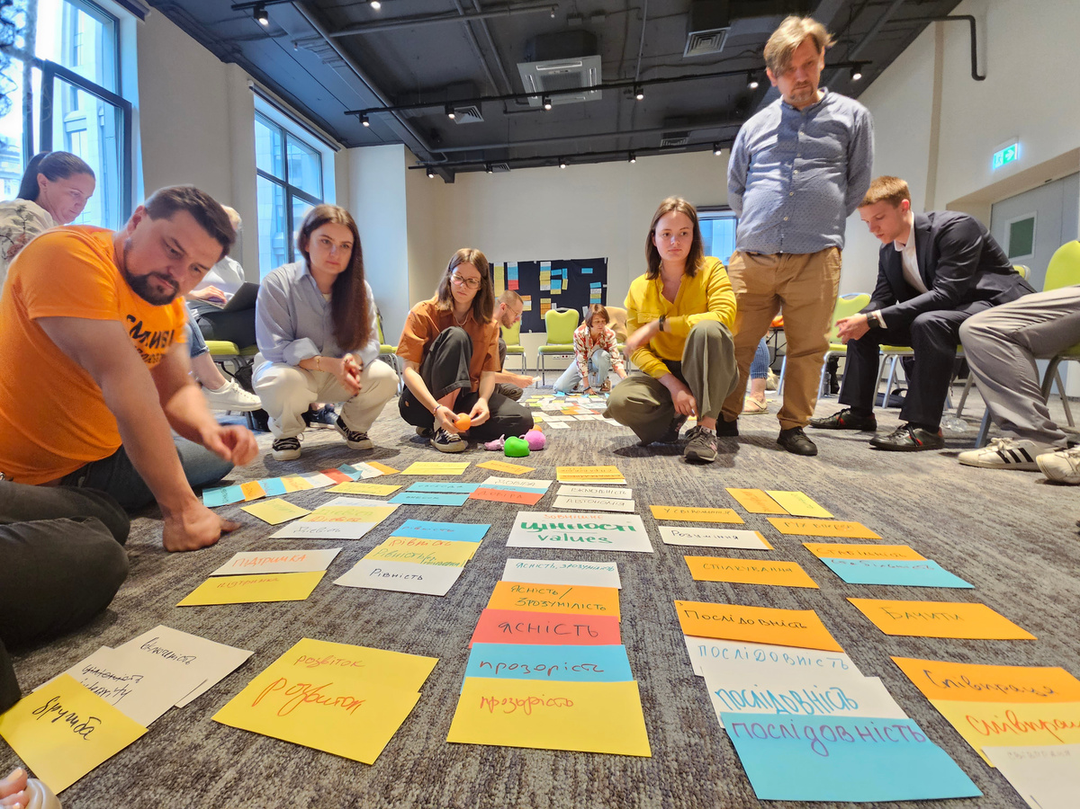
NEXT STEPS
7. Development of a Localization strategy for Ukraine, in cooperation with UN OCHA, NGO Platform, with support at HCT level:
5-year strategy and Strategic plan for 1 year - retreat – tentative dates (December 14-15). NGORC, NNLPD, Caritas Ukraine, ISAR Ednannia, East Europe Foundation preparation.
Consultations with the Government, the scientific community, and the private sector around localization (before the event).
8. Meetings with additional stakeholders to present the draft localization strategy and gather feedback:
  with the Government of Ukraine;
  with a wide circle of institutional donors (December - January).

Slide 10
УКРАЇНСЬКЕ ГРОМАДЯНСЬКЕ СУСПІЛЬСТВО - ЧЛЕНИ СПІЛЬНОТИ/
UKRAINIAN
CIVIL SOCIETY - COMMUNITY MEMBERS
INITIATIVE PLATFORM
STRUCTURE
НАГЛЯДОВА РАДА/
SUPERVISORY BOARD
Направляє ІП/
Guides the IP
Перед ким підзвітна ІП/
To whom is the IP accountable
Очолює ІП/
Leads the IP
СЕКРЕТАРІАТ
SECRETARIAT
РЕГІОНАЛЬНІ ХАБИ/
LOCAL FOCAL POINTS
Зв'язок з регіонами/
connection with regions
КОНСУЛЬТАТИВНІ ГРУПИ/
AD HOC ADVISORY GROUPS
Проводить роботу за
напрямками/
Carries out the work
РОБОЧА ГРУПА/
work groups
РОБОЧА ГРУПА/
work groups
РОБОЧА ГРУПА/
work groups
РОБОЧА ГРУПА/
work groups
РОБОЧА ГРУПА/
work groups
РОБОЧА ГРУПА/
work groups
РОБОЧА ГРУПА/
work groups
Консалтинг стейкхолдерів/
stakeholder consulting

